Slide 1
USM Review
(주)IGS

Slide 2
Block Diagram
Solar Panel
LDO
PCM
Li-Polymer
1Cell
D4V2P
LDO
D3V3P
D3V3P
Ultrasonic Sensor
TX
CC2630
Wireless MCU
I2C
EEPROM
RX
LIS3MDL
Magnetic Sensor
I2C
UART
JTAG
RF Communication

Slide 3
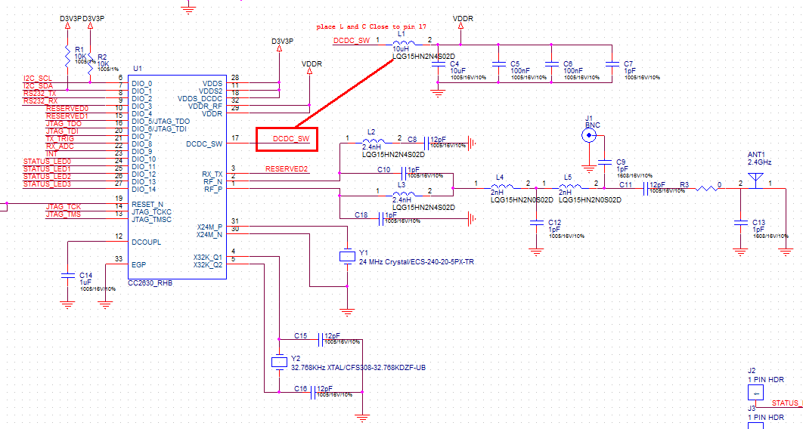
Wireless MCU_CC2630, TI社

Slide 4
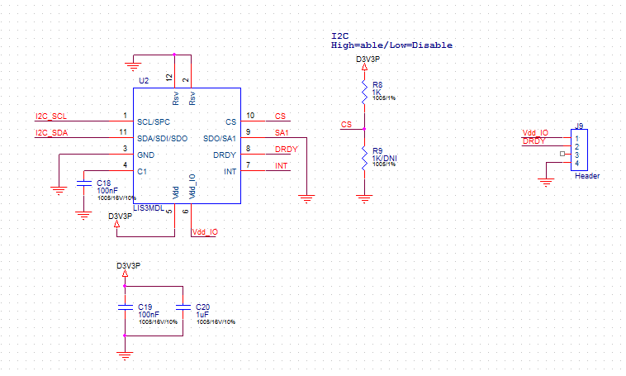
Magnetic Sensor_LIS3MDL, ST社

Slide 5
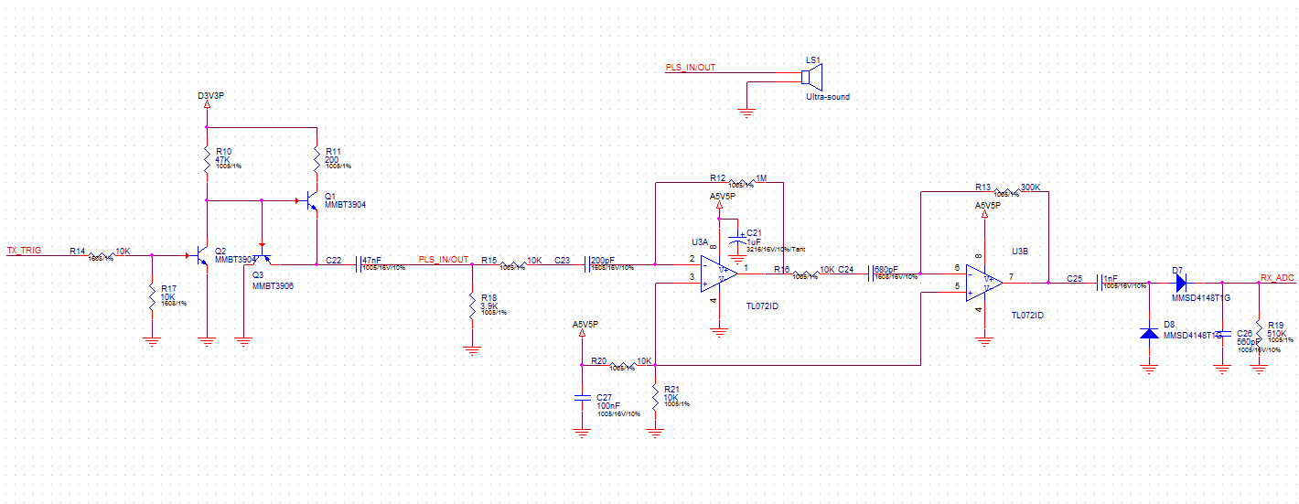
Ultrasonic Sensor

Slide 6
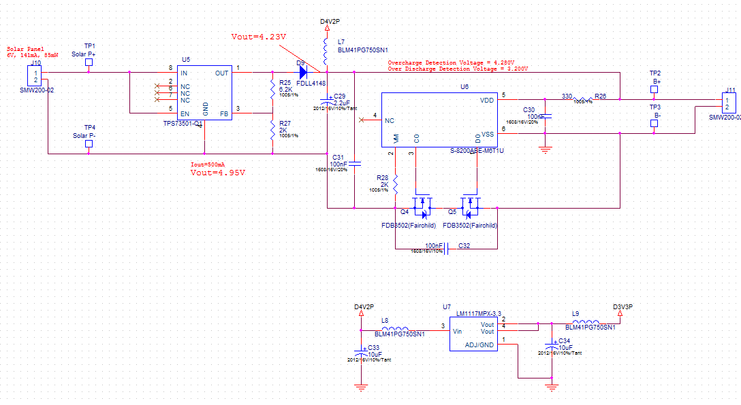
Power_S-8200ABE-M6T1U,SII社

Slide 7
Power
단위: mW
 | CC2630 | LIS3MDL | CAT24C02WI | S-8200ABE-M6T1U | total
D3V3P | 53.446 | 0.891 | 6.6 | 650 | 710
결과 : 기존의 Solar Panel(80*58mm, 85mW) 소비전력 부족함. → Size 키워야함.

